Slide 1
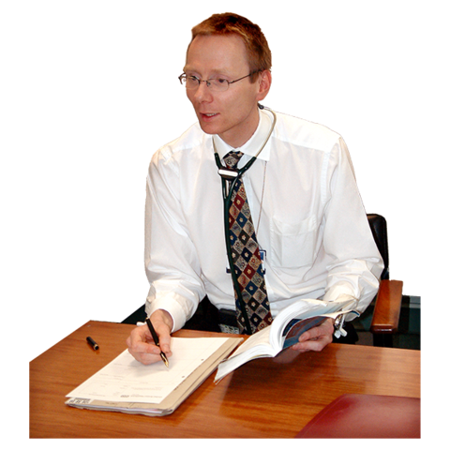
MGS Medical Practice
Having an
Annual Health Check
What Should Happen?

Slide 2
 | You may be asked by your GP to go for an annual health check at your surgery.
 | This leaflet tells you what should happen at your health check.
 | It is important that you know what will happen at your health check,
 | If you have had a health check and your GP or nurse hasn't done what it says in this leaflet, then you should talk to someone at the surgery about it, or talk to a health facilitator in the learning disability team.

Slide 3
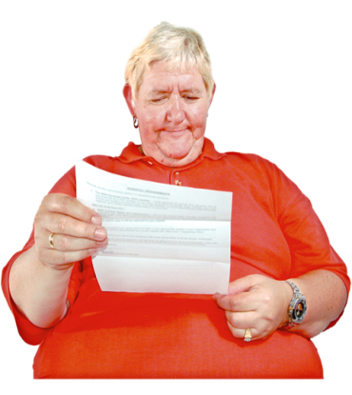
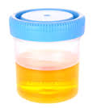
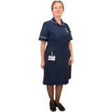
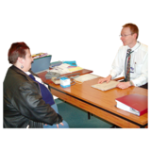
 | You should get an easy read letter asking you to go for a health check.
 | In the letter, you should be asked to bring a urine (wee) sample with you and any medication you take.
 | At your health check, you should see a GP or a nurse. If it’s a nurse, they must be trained to do your physical examination.
 | You will be asked lots of questions about your health and about how you are feeling.

Slide 4
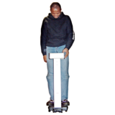
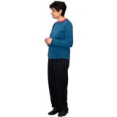
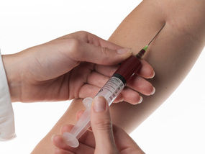
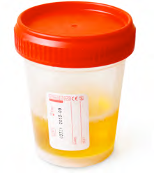
 | You will have your blood pressure checked.
 | And your weight and height.
 | You may be asked to have a blood test.
 | Your urine (wee) sample will be tested. The doctor /nurse will ask you if you have any problems going to the toilet to empty your bladder and bowels (weeing and pooing).

Slide 5
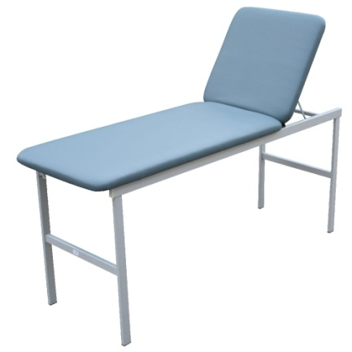
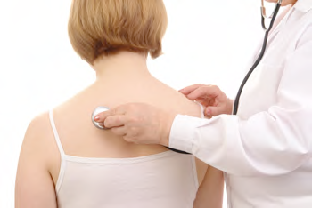
 | The doctor/nurse will use a special light to look in your ears.
 | They will need to check your body. You will be asked to lie on the examination couch.
 | They will listen to your heart and your chest.
 | And will feel your stomach.

Slide 6
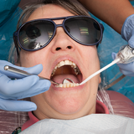
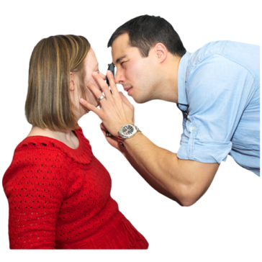
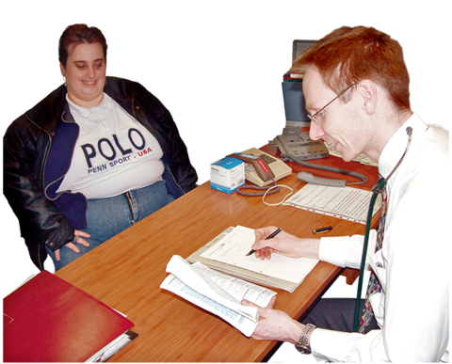
 | They will ask you about the medication you take and whether you have any side effects from them.
 | You will be asked when you last had your teeth and eyes checked.
 | The doctor/nurse will talk to you about how you are feeling and about any health problems you have..
 | If the doctor or nurse decide that you need treatment by them or anybody else ,they must ask for your consent.

Slide 7
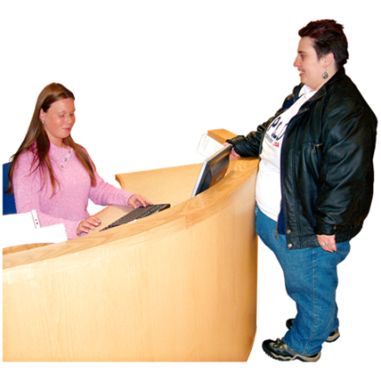
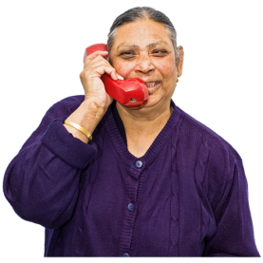
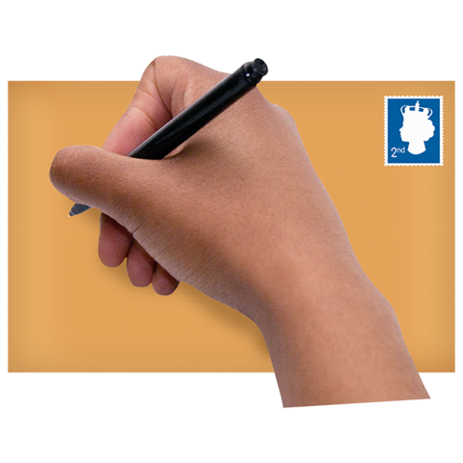
 | You must let someone know if all of these things do not happen at your health check
 | You can show your GP this leaflet before your health check, so that they also know what should happen.
 | If you are not happy with your health check, then you can make a complaint.
 | You can do this at your GP surgery or you can contact NHS England. The receptionist at the surgery can help you with this.

Slide 8
This leaflet was designed by the
Health Facilitation Team
44 Pond Lane
Wolverhampton
WV2 1HG
01902 444447
Developed October 2020

